Slide 1
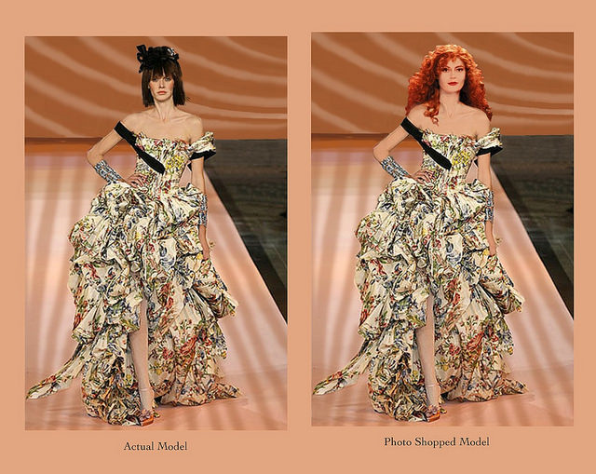

Social Comparison
[Professor Name]
[Class and Section Number]
Notes:
Classroom Recommendations: This class is designed for a single 75-minute class meeting. The class could be abbreviated for a 50-minute session or extended to two class meetings (see notes in IM for specific recommendations for shortening or lengthening).
Overview: This module introduces and applies the concepts related to social comparison processes. Emphasis is placed on applications of the concepts and active student engagement.
Technical Note: These slides may contain simple click animation so that you can focus students’ attention on a particular question, a selection of text, or an image and not have them be distracted by reading ahead. You can either preview the sequence of animation by going through the slides in slideshow view, visiting the animations tab, or reviewing the slide notes. In the notes you will see a cue - (Click) – that corresponds to each animation.
You may also find hyperlinks to outside videos at various places in the slides. These hyperlinks are embedded in text and indicated by color and in the notes section.

Slide 2
Learning Objectives
Understand the reasons people make social comparisons
Identify the consequences of social comparison
Understand the Self-Evaluation Maintenance Model
Explain situational factors that can affect social comparison
Notes:
Purpose: The purpose of this slides is to list the learning objectives from the module.

Slide 3
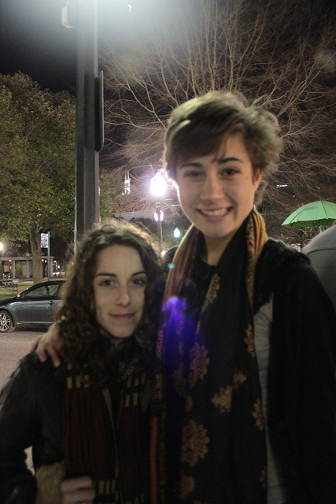
Warm Up: Are You Tall?
How do you know?
Are you taller than 5’6” (1.68 m)?
Notes:
Warm Up: Are you Tall? The purpose of this slide is to introduce the concept of social comparison by prompting students to consider a self-relevant trait that will likely elicit comparison
Ask students to consider the question: are you tall? Give them a couple of moments to come up with an answer in their own minds or elicit student responses to the question.
(Click): How do you know?
Ask students what information they used to answer the question. It is likely that they will give answers such as considering an objective measure of their height (e.g., in feet/inches or meters), but students will likely also offer answers having to do with comparing their heights to others.
(Click): Are you taller than 5’6” (1.68 m)?
Ask students how they approach answering this question differently from the more general question (are you tall?). This question is based on an objective measure, and so can be answered without considering others. However, the more general question requires comparison to others to answer.

Slide 4
Overview
Social Comparison: Basics
  Relevance & Similarity
  Direction of Comparison
Activity: Build the Best Structure
Consequences of Social Comparison
Individual Differences and Situational Factors
Application: Social Comparison & Body Image
Related Phenomena
Activity: Minute Paper
Notes:
The purpose of this slide is to provide students with an overview of the material that will be covered during the lecture

Slide 5
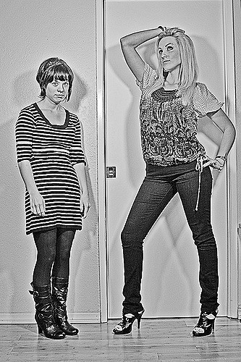
Social Comparisons: Basics
Self-Evaluation
Relevance & Similarity
Direction of Comparison
  Downward
  Upward
Notes:
Purpose: The purpose of this slide is to introduce and describe the basic concepts of the social comparison process.
Self-Evaluation: People seek information about themselves in order to assess how their beliefs fit the social norms and to assess the level of their abilities. This information helps us to shape our self-concept and to make adjustments where we perceive discrepancies between our current beliefs/behavior and our goals.
(Click): Relevance & Similarity
We are most likely to use social comparison in order to evaluate opinions and performance that we find self-relevant. If a trait or ability isn’t important to us or our self-concept, we’re less likely to socially compare that trait or ability to others, whereas when it is a trait or ability we care about, we’re usually motivated to consider how we’re doing compared to others. For example, as students, you’re likely to compare your performance as a student to other students, as academic performance is probably relevant to your self-concept.
We will typically compare ourselves to peers or those who are otherwise similar to us, because these are the people who are most relevant to our self-concept. For example, let’s say that a student earns a 70% on an exam. That student is likely to be curious about how their score compared to classmates’ scores on the exam. This comparison helps us to interpret our performance in context.
(Click): Direction of Comparison
When we compare our traits or abilities to others, we may focus on others who are doing better or worse than us.
(Click): When we compare ourselves to people who are doing worse than us on some trait or ability, this is called a downward comparison. For example, if you learned that your score of 70% was better than the class average, or that your friend in class scored 55%, you would be making a downward comparison.
(Click): When we compare ourselves to people who are doing better than us on some trait or ability, this is called an upward comparison. For example, if you learned that your score of 70% was worse than the class average, or that your friend in class scored 85%, you would be making an upward comparison.

Slide 6
Overview
Social Comparison: Basics
Activity: Build the Best Structure
Consequences of Social Comparison
Individual Differences and Situational Factors
Application: Social Comparison & Body Image
Related Phenomena
Activity: Minute Paper
Notes:
The purpose of this slide is to provide students with an overview of the material that will be covered during the lecture

Slide 7
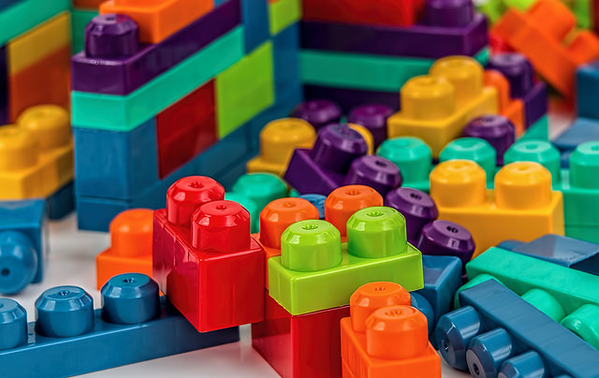
Activity: Build the Best Structure
Notes:
Purpose—The purpose of this activity is to get students to engage in social comparison. They will be asked to apply the concepts of upward and downward comparison, experience the consequences of social comparison processes, and this can be used to frame presentation of content about self-evaluation maintenance model on the following slides. See detailed description of the “Build the Best Structure” activity in the instructor’s manual.
The purpose of this activity is to induce social comparison and explore its consequences. Many domains in which students naturally engage in social comparison (egs. athletic performance, academic performance) may be idiosyncratic to each student’s self-concept. Also, due to the potential for to threats to self-esteem, using existing traits/abilities for a comparison activity could lead to discomfort and reactivity. This activity introduces a new, temporary, and low-stakes performance domain in which students can more safely engage in upward and downward comparison and observe firsthand the consequences of comparison in ways that are consistent with the self-evaluation model
Time: 25 minutes
Materials: PowerPoint slide, building blocks (enough for students to build structures in groups of 4-5; approximately 15-20 blocks per group; best if blocks are varied in size and shape)
Directions:
Separate students into groups of 4 or 5 and give each group a set of blocks.
Instruct them to build “the best structure” they can. It is important to be intentionally vague about what constitutes “best”. If students ask for clarification, tell them to discuss it with their group and decide amongst themselves what defines “best”. Give students about 5-10 minutes to build their structures.
While groups are working, walk around and listen for evidence that the groups are engaging in social comparison. The students may not spontaneously discuss any ways in which their structure compares to other groups at this point; if they do, this can be used as examples to illustrate concepts during the discussion portion of the activity.
After building phase, tell students that the class will now determine which group’s structure is best. Ask for suggestions on criteria to determine which structure is best (e.g., tallest, used the most blocks, most stable, most creative). If available, these could be listed on the board; otherwise, instructor can simply note the criteria that are suggested. Depending on class size and number of groups, you could have each group suggest a single criterion. Ideally, the list will include 3-5 criteria.
Have the students determine the winner for each criterion; this can be done through a formal vote (you may wish to allow groups to lobby for their structure prior to a vote) or an informal discussion. The important point is that students be prompted to compare their structure to other groups’ structure.
Discuss the activity. Questions and potential connections to concepts include:
Did most groups vote for criteria that are relevant to their group’s definition of “best”? Comparison processes occur along self-relevant dimensions, with similar peers.
When groups “won” or “lost” for a particular criterion, what type of comparison were they engaging in? Winning for a particular criterion reflects downward comparisons, whereas losing for a particular criterion reflects upward comparison.
How did students feel when their group won or lost? The students are likely to feel more positively when they won (downward comparison) than lost (upward comparison). If they won for a particular criterion, did they emphasize the importance of that criterion (self-enhancement effect)?
Did any group lose on a criterion that they, themselves, nominated? How did they react? If the group selected the criterion, and then did not perform well on that criterion, did they change their focus to another criterion (distancing from trait, in self-evaluation maintenance model)?
How do individual differences and situational factors impact these processes? Did some students care more or less about how their group’s structure compared to other groups’ structures? Did this relate to mastery goals and mindset? Did the number of students in the class or close physical proximity to the other groups impact this? Were there more debates about which group should win for a particular criterion when it was a close-call between groups (relates to proximity to a standard, counterfactuals)?
If time permits, you could give students a final 2 minutes to improve on their structure (or just have them imagine having this opportunity). What would they do to improve their structure? It is likely they would focus on whichever criterion sets their group’s structure most apart from the other groups. This illustrates the self-evaluation maintenance model and speaks to the differences in consequences resulting from anticipated opportunities for additional evaluation (e.g., less negative competition with others, focus on improvement rather than derogation of the comparator).

Slide 8
Overview
Social Comparison: Basics
Activity: Build the Best Structure
Consequences of Social Comparison
  Consequences of Downward Comparisons
  Consequences of Upward Comparisons
  Self-Evaluation Maintenance Model
Individual Differences and Situational Factors
Application: Social Comparison & Body Image
Related Phenomena
Activity: Minute Paper
Notes:
The purpose of this slide is to provide students with an overview of the material that will be covered during the lecture

Slide 9
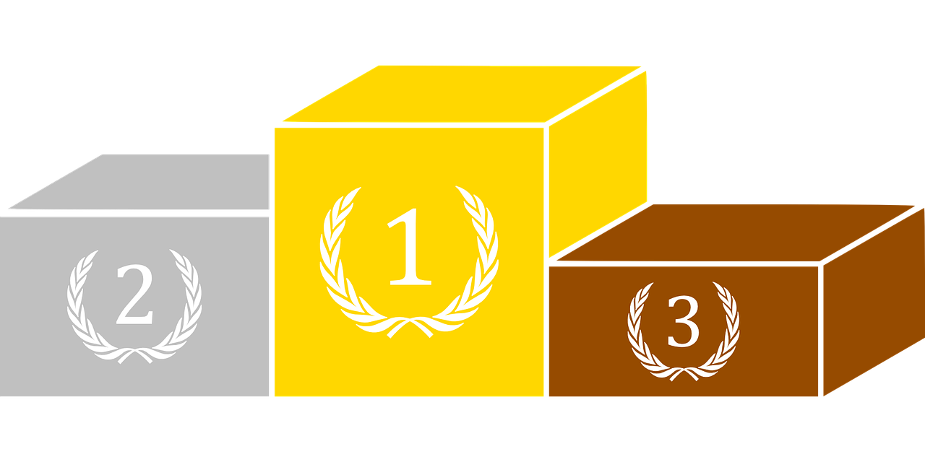
Consequences of Social Comparison
Consequences of Downward Comparisons:
  Self-Enhancement Effect
  Behavioral Consequences
Consequences of Upward Comparisons:
  Counterfactuals
  Behavioral Consequences
Self-Evaluation Maintenance Model
Notes:
Purpose: The purpose of this slide is to formalize the concepts related to consequences of social comparison, which likely came up in the previous activity.
(Click): Consequences of Downward Comparisons: When we shine in comparison to others, it tends to boost our feelings of self-esteem. Engaging in downward social comparison can lead to the self-enhancement effect, where we get a boost to our self-concept on the trait/ability serving as the basis of comparison. For example, students may have felt a boost to their self-esteem when their group’s structure was judged as best on some evaluation criterion. Likewise, gold medalists may feel a boost to their self-concept as athlete and derive satisfaction from the comparison to their more poorly performing peers.
(Click): Behavioral Consequences: This boost to self-esteem can have positive behavioral consequences, such as making us more motivated to continue engaging in behaviors relevant to the dimension of comparison. For example, if I score well on an exam compared to classmates, I might be encouraged to keep working on that skill, even in the face of obstacles. It can also help us to cope with challenges. For example, research in health psychology shows that cancer patients who focus on downward comparisons (comparing themselves to people with worse symptoms, diagnoses, or outcomes) can cope better with their own circumstances (see below for citation of source by Taylor & Lodel, 1989, which reviews this research). However, it can also lead to negative behavioral consequences, such as treating those who are doing more poorly than we are with scorn or disrespect.
(Click): Consequences of Upward Comparisons: When we make upward comparisons, it can challenge our self-esteem or threaten our self-concept. The silver medalist may feel frustrated about their performance compared to the gold medalist, and may start to question their athletic abilities, threatening their self-esteem.
(Click): Counterfactuals: These negative consequences are especially likely for our silver medalist, as they are easily able to come up with counterfactual thoughts that focus on their performance compared to the gold medalist (e.g., “If only I’d run faster/gotten a better start/stuck that landing”). Because the bronze medalist is more likely to focus on counterfactuals that focus on how close they were to missing out on medaling at all (e.g., “What if I’d been just a bit slower/gotten a poor start/missed that landing”), inducing downward comparison, we often (and counterintuitively) find that silver medalists will be less satisfied with their performance than bronze medalists, despite the fact that they objectively outperformed those bronze medalists.
(Click): Behavioral Consequences: Upward comparisons can cause some positive behavioral consequences, such as engaging in efforts at self-improvement, trying to learn from our more successful peers, or feeling admiration for their success. For example, the research on social comparison in cancer patients shows that, while they tend to engage in downward comparison, they also tend to seek interaction with upward comparators, from whom they can learn and who reinforce feelings of hope and optimism. However, the threat to self-esteem can also cause us to engage in negative behaviors, such as acting aggressively toward our more successful comparator.
(Click): Self-Evaluation Maintenance Model: The self-evaluation maintenance model expands on these ideas to explain a couple additional likely consequences of social comparison. The basic idea of this model is that our response to social comparison will be based upon whatever can help to maintain, reinforce, or repair our self-esteem and self-concept. If we engage in downward comparison, for example, we are likely to place even more importance on that trait or ability in our self-concept, because doing so allows us to bolster our self-esteem further. On the other hand, when an upward comparison threatens our self-esteem, we are likely either to minimize that aspect of our self-concept (e.g., deciding that trait or ability is actually not that important to how we see ourselves) or we will distance ourselves from the more successful comparator. This model explains why we are actually more likely to be upset when we are outperformed by a friend than a stranger. Because we care more about how we look to important others, a friend’s success is a larger threat to our self-esteem and self-concept. One way we cope with this is to avoid spending time with that friend. On the other hand, if we minimize the trait in our self-concept, we might reinforce our connection to our more successful friend, because now we can bask in their reflected glory, causing feelings like pride and admiration for our friend’s accomplishment.
Reference:
Taylor, S. E., & Lobel, M. (1989). Social comparison activity under threat: downward evaluation and upward contacts. Psychological Review, 96, 569-575.
This article is a high-impact and oft-cited article applying social comparison to health outcomes. Taylor and Lobel describe the tendency of patients to engage in downward comparison for evaluation purposes and to engage in upward affiliation and information-seeking behaviors. Both of these divergent strategies have been associated with benefits in coping and outcomes for patients.

Slide 10
Overview
Social Comparison: Basics
Activity: Build the Best Structure
Consequences of Social Comparison
Individual Differences and Situational Factors
Application: Social Comparison & Body Image
Related Phenomena
Activity: Minute Paper
Notes:
The purpose of this slide is to provide students with an overview of the material that will be covered during the lecture

Slide 11
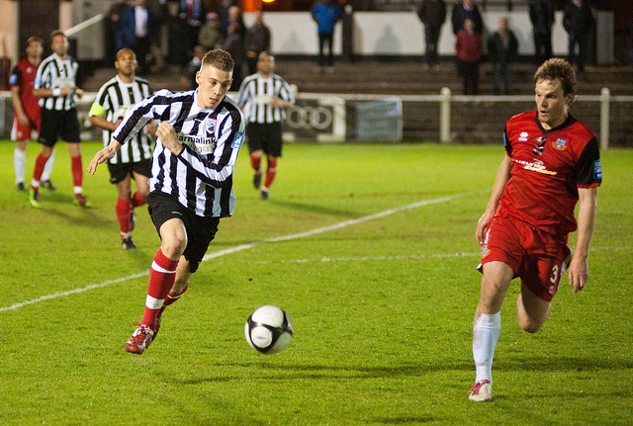
Individual Differences and Situational Factors
Individual Differences
  Mastery Goals
  Fixed vs. Growth Mindset
Situational Factors
  Number of Comparators
  Local Comparators
  Proximity to a Standard
  Social Category Lines
Notes:
Purpose: The purpose of this is to describe the factors that moderate social comparison phenomena
Note: The following examples refer to the game of football, which is referred to as soccer in the U.S. Outside of the U.S., all references to “soccer” could be replaced with “football”.
(Click): Individual Differences: Social comparison and its effects depend on certain personality traits.
(Click): Mastery Goals: Individuals who are focused on mastering some skill tend to experience upward comparisons as less of a threat to their self-esteem. Because they are focused on improvement, they are likely to respond to upward comparisons in more adaptive ways, such as focusing on how they can learn from their more successful peers, and seeing their relative lack of success as a challenge instead of as a threat. For example, a soccer player with a mastery goal appraises taking a loss as an opportunity to learn from their competitors and improve their skills.
(Click): Fixed vs. Growth Mindset: Some individuals tend to consider their traits and abilities as relatively stable and unchangeable. These people have a “fixed” mindset. They tend to experience upward comparisons as more of a threat to their self-esteem and self-concepts. If a soccer player has a fixed mindset, she might believe she’s as good as she’ll ever get at soccer. Therefore, if she loses a soccer game, she’s more likely to distance herself from that part of her self-identity. Other individuals have a growth mindset, where they believe they are capable of changing, growing, and developing their traits and abilities compared to their current state. These individuals are more likely to view an upward comparison as a temporary set-back, and to make efforts to develop and improve upon their skills. A soccer player who loses a game but has a growth mindset is likely to focus on how they can improve their skills for the next game or get better over time.
(Click): Situational Factors: Regardless of these individual differences, all people are more likely to engage in social comparison in certain circumstances.
(Click): Number of Comparators: For example, we tend to feel pressure to compare ourselves to others when we are competing against fewer others than when we are competing against a large group of others. This is referred to as the N-effect. Consider the “Build the Best Structure” activity. Do you think your responses would have been different if you’d been competing against fewer classmates in a smaller class? If you were competing against many more classmates in a larger class?
(Click): Local Comparators: People tend to be more sensitive to comparisons to people who are physically near. Soccer players are likely to find comparisons to other players on their team, or to other teams in their league, than they are to compare themselves to soccer players on other teams or in other leagues.
(Click): Proximity to a Standard: When our performance is being compared to some external or qualitatively significant standard, social comparison effects tend to be more pronounced. For example, if a team’s next soccer game will determine whether their team wins the entire league, they will likely be more attuned to how their performance compares to others. Likewise, if the team’s next game would determine whether they will be worst in the entire league, they will similarly be more attuned to social comparison processes. On the other hand, if the team’s performance is somewhere in the middle of the league, the team will likely be less affected by social comparison.
(Click): Social Category Lines: Finally, when individuals align with a certain social category or group, social comparison can occur at the level of the group as a whole instead of, or in addition to, at the level of the individual. For example, soccer players are likely to compare their performance to other players on their team, but they are also likely to compare across the social category of team, so that they evaluate their team’s performance, as a whole, to other teams, as a whole.

Slide 12
Overview
Social Comparison: Basics
Activity: Build the Best Structure
Consequences of Social Comparison
Individual Differences and Situational Factors
Application: Social Comparison & Body Image
Related Phenomena
Activity: Minute Paper
Notes:
The purpose of this slide is to provide students with an overview of the material that will be covered during the lecture

Slide 13
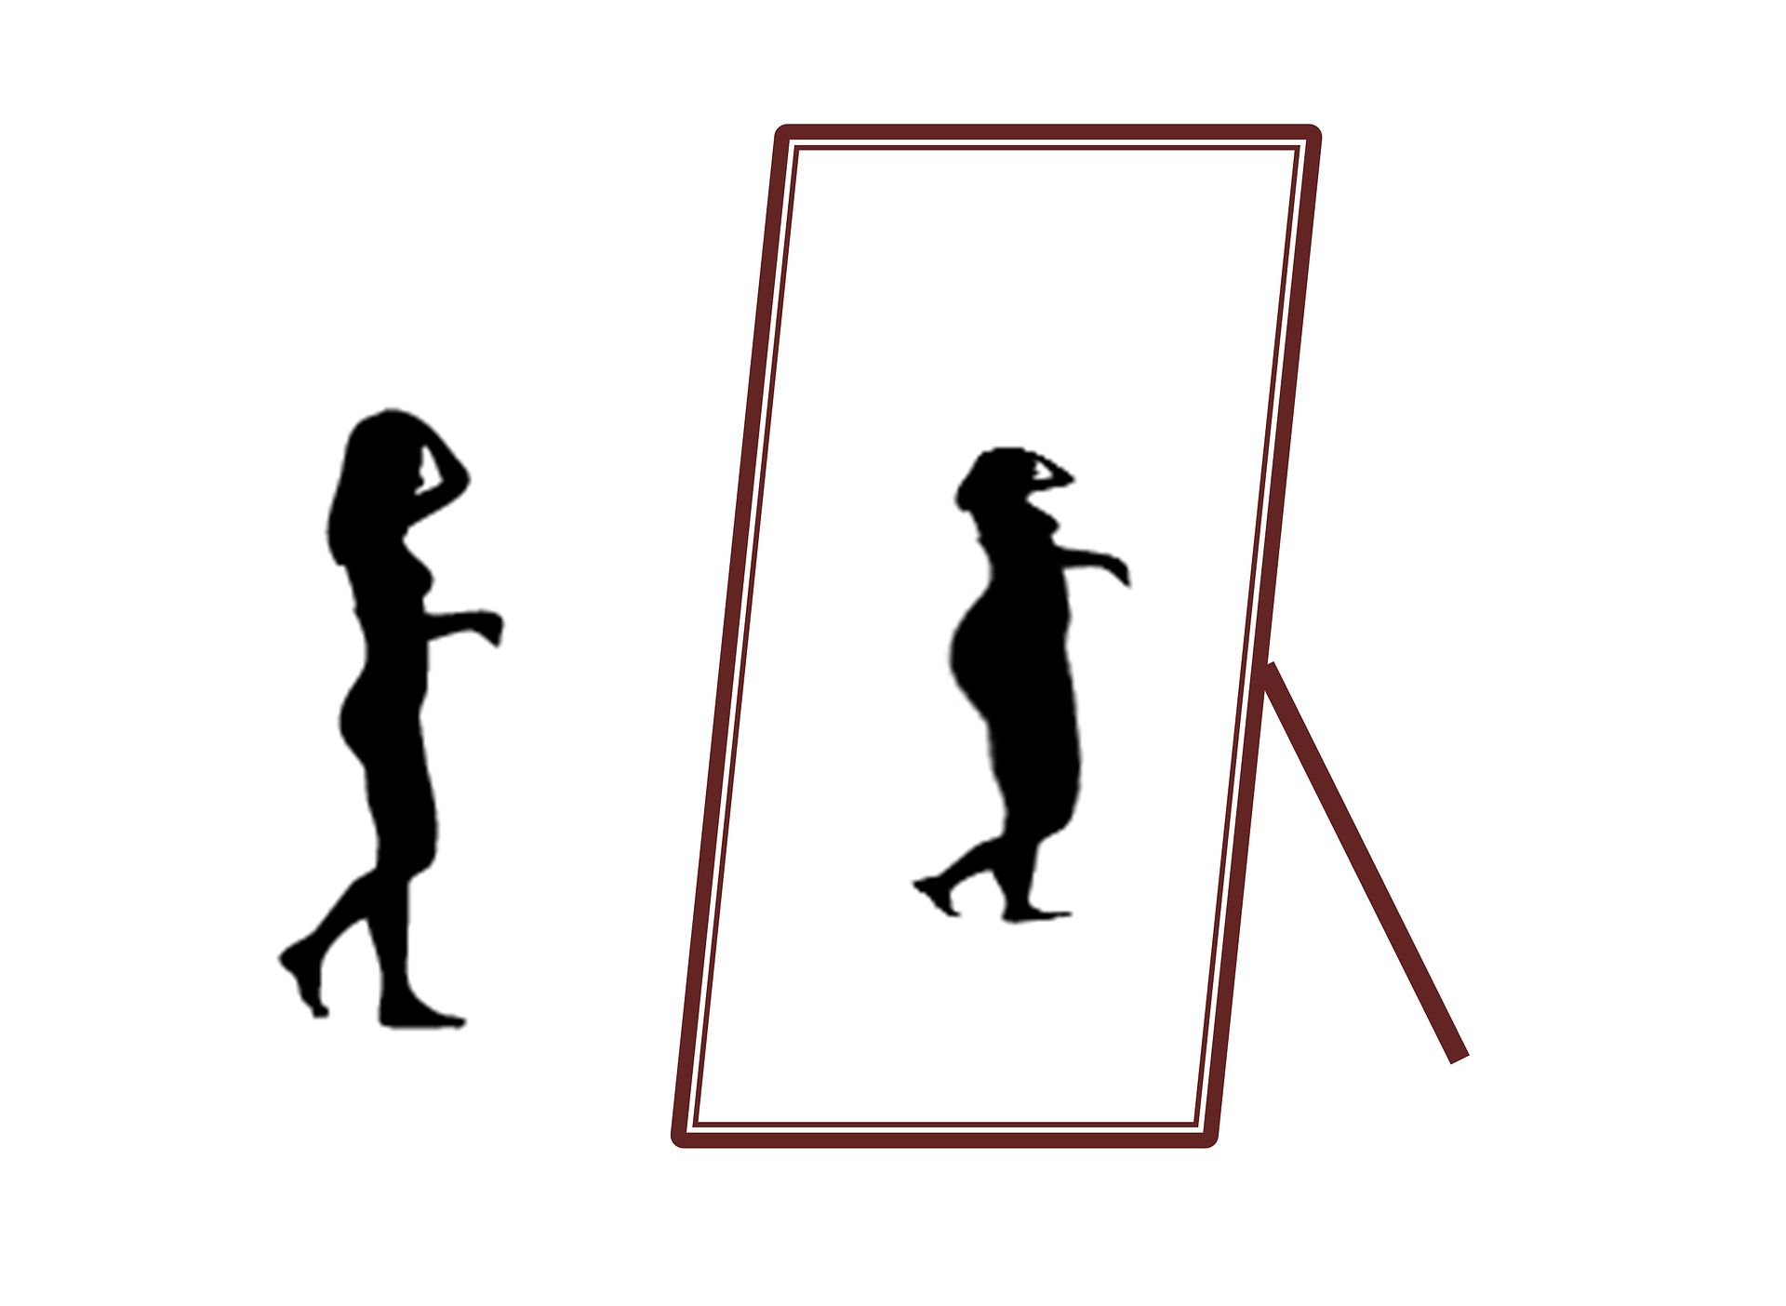
Application: Social Comparison
& Body Image
“The Mirror in My Mind: Body Image and Self-Esteem”
Notes:
Purpose: The purpose of this slide is to help students see how these social comparison concepts apply to real-life problems. The video is located at: http://clipsforclass.com/social.html
Notes:
After showing the video (click on link to stream video; click on CC button to turn on closed captions), reinforce main points or open to class discussion. Main concepts that can be discussed include:
How unrealistic beauty ideals in media images induce upward comparison
How these upward comparisons impact self-esteem. How might the impact of exposure depend on age, gender, weight status, or other individual differences (those discussed in PowerPoint or others)?
How might these self-esteem consequences affect behaviors, including how someone dresses, eats (including links to eating disorders/chronic dieting, etc.), exercises, etc.?
What are some ways in which the concepts of social comparison could be used to help protect people from these negative consequences?

Slide 14
Overview
Social Comparison: Basics
Activity: Build the Best Structure
Consequences of Social Comparison
Individual Differences and Situational Factors
Application: Social Comparison & Body Image
Related Phenomena
  Frog Pond Effect
  Dunning-Kruger Effect
Activity: Minute Paper
Notes:
The purpose of this slide is to provide students with an overview of the material that will be covered during the lecture

Slide 15
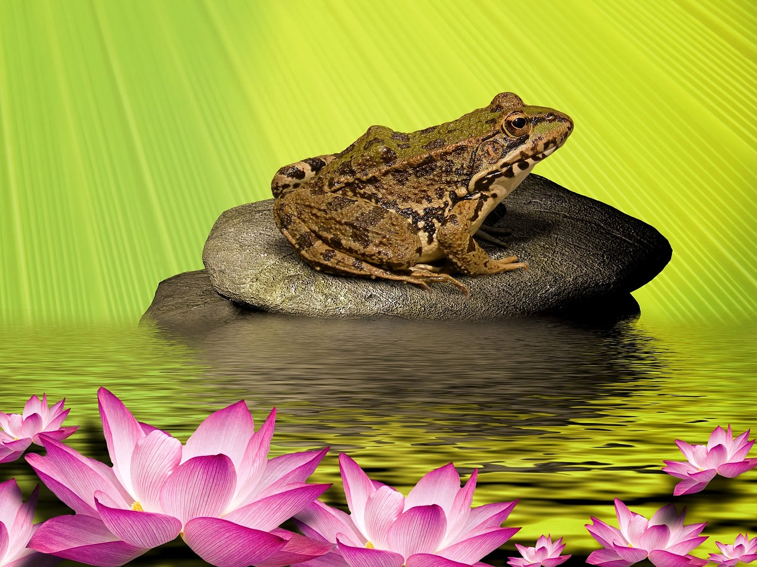
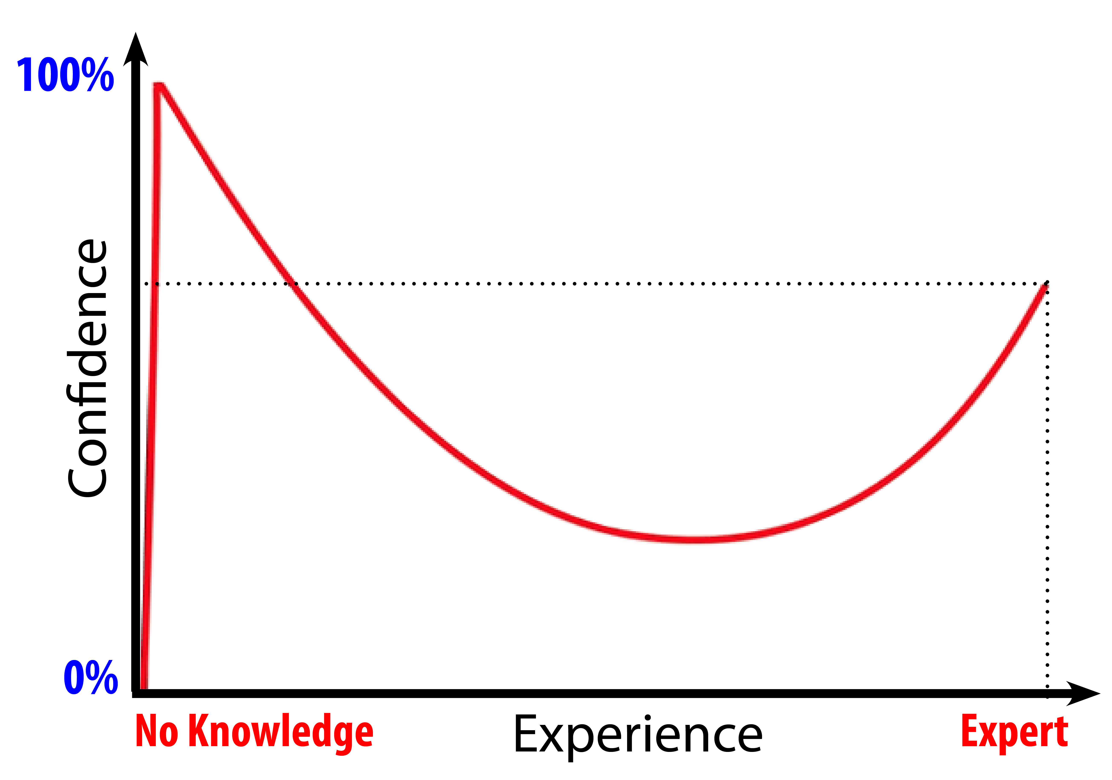
Related Phenomena
Frog Pond Effect
Dunning-Kruger Effect
Notes:
Purpose: This slide is meant to describe two specific phenomena that are both related to social comparison processes: the frog pond effect and the Dunning-Kruger effect.
Notes:
(Click): Frog Pond Effect: Because we tend to experience the consequences of downward comparison as more positive and desirable than those of upward comparisons, we sometimes select circumstances that make downward comparisons more likely. In general, when given the choice, people prefer to be more successful, even in comparison to fewer others or in comparison to a more modest standard than to perform well in comparison to a larger number of successful others, even if their overall performance is objectively stronger. Most people prefer to be a big frog in a small pond than a small frog in a bigger pond. A strong student might prefer to shine at a smaller and less competitive university than to do well, but not be extraordinary, in a larger or more competitive university. The small university provides more potential opportunities for downward comparison, boosting self-esteem, whereas the more challenging university might induce more upward comparison, threatening self-esteem.
(Click): Dunning-Kruger Effect: Finally, it is also worth noting that the processes of social comparison are based upon our subjective perceptions of how we’re doing, compared to others, whether or not those perceptions are objectively accurate. One of the implications of this is that sometimes we are more or less confident of our performance than is objectively warranted, given how our performance compares to others. The Dunning-Kruger effect refers to the fact that unskilled individuals are often overconfident about their performance. They often dramatically overestimate how well they do compared to their peers, for example. In the original study by Dunning-Kruger (2003), the individuals who objectively scored in the lowest 25% of performers mistakenly estimated their performance to be above-average (at approximately the 60th percentile). This is explained as resulting from a “double curse”: not only are these people “cursed” to do poorly, but they are also “cursed” to be unable to recognize their poor performance, and accordingly, are unlikely to make efforts to improve. Because it takes some level of mastery to recognize competence, these individuals lack the ability to recognize their lack of skill. In contrast, the individuals who objectively scored in the top 25% of performers actually underestimated their level of performance, believing themselves to be less successful than they were. This seems to be due to the fact that they attribute their success relatively more to the ease of the task and less to their skill than is objectively warranted. Because we are likely to be confident both in circumstances where we’re skilled and in circumstances where we are least skilled, we should be cautious in equating confidence with competence.

Slide 16
Overview
Social Comparison: Basics
Activity: Build the Best Structure
Consequences of Social Comparison
Individual Differences and Situational Factors
Application: Social Comparison & Body Image
Related Phenomena
Activity: Minute Paper
Notes:
The purpose of this slide is to provide students with an overview of the material that will be covered during the lecture

Slide 17

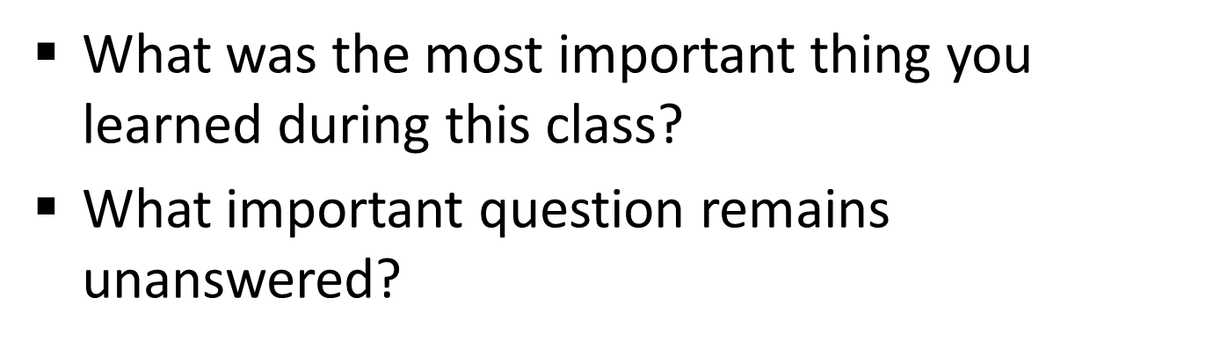
CAT: One-Minute Paper
Notes:
Classroom Assessment Technique (CAT): One-Minute Paper
If you are presenting the information on one class day, you might end the material about here. End your class time with a one-minute paper.
The Minute Paper tests how students are gaining knowledge, or not. The instructor ends class by asking students to write a brief response to the following questions: “What was the most important thing you learned during this class?” and “What important question remains unanswered?”
Have students briefly answer these questions in writing and turn them in. After class, assess students’ responses. At the beginning of the next class, go over any misunderstandings or relevant questions.
If you do not conclude with this Classroom Assessment Technique (CAT), it would helpful to use another CAT. It could be in the form of a:
Muddy point
One-minute paper
Background knowledge
What’s the Principle?
Defining features Matrix:
For more information on CATs click here: http://cft.vanderbilt.edu/guides-sub-pages/cats/

Slide 18
Photo Attribution
Slide 1 | Photo Credit: Compare Models PINKÉ https://www.flickr.com/photos/8113246@N02/27763043690/ https://creativecommons.org/licenses/by-nc/2.0/
Slide 3 | Photo Credit: IMG_1409 Will Gurley https://www.flickr.com/photos/58187514@N06/5358518621/ https://creativecommons.org/licenses/by-nc-sa/2.0/
Slide 5 | Photo Credit: [365] 054 Corie Howell https://www.flickr.com/photos/53628108@N00/3354726179/ https://creativecommons.org/licenses/by-nc-nd/2.0/
Slide 7 | Photo Credit: Colorful Duplo Building Blocks Image Catalog https://www.flickr.com/photos/image-catalog/22793927699 https://creativecommons.org/publicdomain/zero/1.0/
Slide 9 | Photo Credit: Podium michaljamro https://pixabay.com/en/podium-sport-trophy-victory-medal-1060918/ https://creativecommons.org/publicdomain/zero/1.0/deed.en
Slide 11 | Photo Credit: Maidenhead Utd vs Eastleigh FC Chris Turner https://www.flickr.com/photos/25909489@N02/5621622138/ https://creativecommons.org/licenses/by-nc-nd/2.0/
Slide 13 | Photo Credit: Weight Loss Tumisu https://pixabay.com/en/weight-loss-slimming-diet-health-494284/ https://creativecommons.org/publicdomain/zero/1.0/deed.en
Slide 15 | Photo Credit: Frog bykst https://pixabay.com/en/frog-water-lily-stone-water-1463266/ https://creativecommons.org/publicdomain/zero/1.0/deed.en Photo Credit: Noba Staff https://creativecommons.org/licenses/by-nc-sa/4.0/deed.en_US
Slide 17 | Photo Credit: Illustrated silhouette of a black cat nehtaeh79 http://www.freestockphotos.biz/stockphoto/16624 http://creativecommons.org/publicdomain/zero/1.0/
Notes:
Photo Attribution Slide

